Slide 1
Geotechnical analysis
METHOD
THEORETICAL REQUIREMENTS
OF
Equilibrium
Compatibility
Constitutive
Boundary Conditions
ANALYSIS
Behaviour
Force
Disp.
Closed Form
Linear
Elastic
Rigid with
Limit Equilibrium
a failure
criterion
Rigid with
Stress Field
a failure
criterion
Limit
L.B.
Ideal
Analysis
U.B.
Plasticity
Any
Full Numerical

Slide 2
Geotechnical analysis
Basic failure criteria of classical soil mechanics
Tresca failure criterion
- total stress approach -
τ
S
u
τ_{f}
σ_{3f}
σ₃
σ₁
σ_{1f}
σ
Stress state at failure
Initial stress state
S
u

Slide 3
Geotechnical analysis
Basic failure criteria of classical soil mechanics
Mohr-Coulomb failure criterion
- effective stress approach -
τ
φ’
τ_{f}
σ_{3f}
σ₃
σ₁
σ_{1f}
σ’
c’
σ_{n}
Stress state at failure
Initial stress state
φ’

Slide 4
Limit Equilibrium analysis
Lecture objectives:
to define assumptions involved with this method of analysis
to apply limit equilibrium to the solution of geotechnical structures

Slide 5
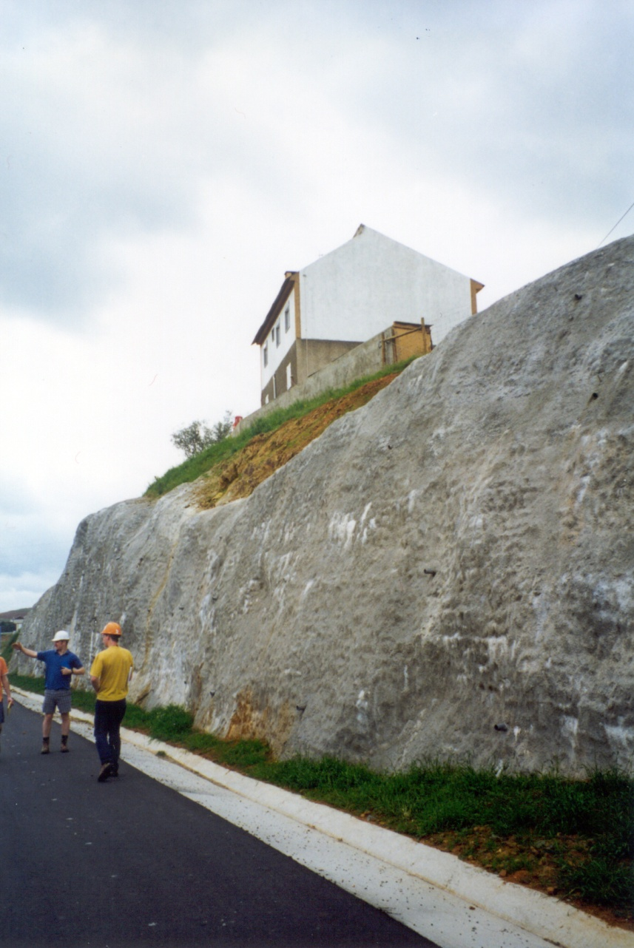
Limit Equilibrium
Geotechnical structure:
CUTTING
What is depth of
excavation, H?
H=?

Slide 6
Limit Equilibrium
Vertical cut
Idealised model of the
vertical cut in plane strain geometry
H=?
H=?

Slide 7
Limit Equilibrium
Assumptions of the method
1. Arbitrary failure surface to a problem (position, shape)

Slide 8
Limit Equilibrium
Assumptions of the method
b
c
Rigid
failure surface
β
or
a
Rigid
1. Arbitrary failure surface to a problem (position, shape)
2. Assumes failure condition everywhere along failure surface,
while block and remaining soil are rigid

Slide 9
Limit Equilibrium
Assumptions of the method
b
c
Rigid
failure surface
β
or
a
Rigid
3. Applies equilibrium only to the failing soil mass – considered
to be between failure surface and boundaries of the problem

Slide 10
Limit Equilibrium
Assumptions of the method
P
q
b
c
Q
W-self weight
τ
σ_{n}’
β
a
4. Forces acting on the failing soil mass:
- external (includes self-weight)
- Internal (only in the shear surface)

Slide 11
Limit Equilibrium
Assumptions of the method
b
c
β
a
5. Global equilibrium considers:
- sum of forces in two perpendicular directions (2 eq.)
- one moment equilibrium (1 equation)

Slide 12
Limit Equilibrium
Assumptions of the method
b
c
β
a
6. To define each force we need:
- its magnitude
- its direction
- its line of action

Slide 13
Limit Equilibrium
Solution of the problem of vertical cut
b
c
W
τ
H=?
σ’
β
Mohr-Coulomb fc:
a
External forces:
self weight, W
Internal forces:
- direct stress, σ’
- shear stress, τ

Slide 14
Limit Equilibrium
Solution of the problem of vertical cut
b
H.tanβ
c
Mohr-Coulomb fc:
W.sinβ
W
W
τ
H=?
W.cosβ
σ’
β
l
a
Applying equilibrium in two perpendicular directions:
1
2

Slide 15
Limit Equilibrium
Solution of the problem of vertical cut
b
H.tanβ
c
Noting that:
W.sinβ
W
W
τ
3
H=?
W.cosβ
σ’
4
β
l
a
Applying equilibrium in two perpendicular directions:
1
2

Slide 16
Limit Equilibrium
Solution of the problem of vertical cut
Applying equilibrium in two perpendicular directions:
1
2
Noting that:
3
4
Combining 1 to 4 in the top equation:

Slide 17
Limit Equilibrium
Solution of the problem of vertical cut
Equation for H - depends on unknown angle β:
Critical value of β is obtained from
which can only equal 0 if:
Substituting β into top equation gives Limit Equilibrium value of H:

Slide 18
Limit Equilibrium
Solution of the problem of vertical cut
β
β
β
β
Polygon of forces

Slide 19
Limit Equilibrium
Solution of the problem of vertical cut
β
β
β
β
- Only force equilibrium has been used to obtain the solution
- Moment equilibrium around ‘a’ gives line of action for force N

Slide 20
Limit Equilibrium
Summary of the method’s assumptions
1. Arbitrary failure surface to a problem (position, shape)
2. Assumes failure condition everywhere along failure surface,
while the block and the remaining soil are rigid
3. Applies equilibrium only to the failing soil mass – considered
to be between failure surface and boundaries of the problem
4. Forces acting on the failing soil mass:
- external (includes self-weight)
- Internal (only in the shear surface)
5. Global equilibrium considers:
- sum of forces in two perpendicular directions (2 eq.)
- one moment equilibrium (1 equation)
6. To define each force we need:
- its magnitude
- its direction
- its line of action

